Slide 1
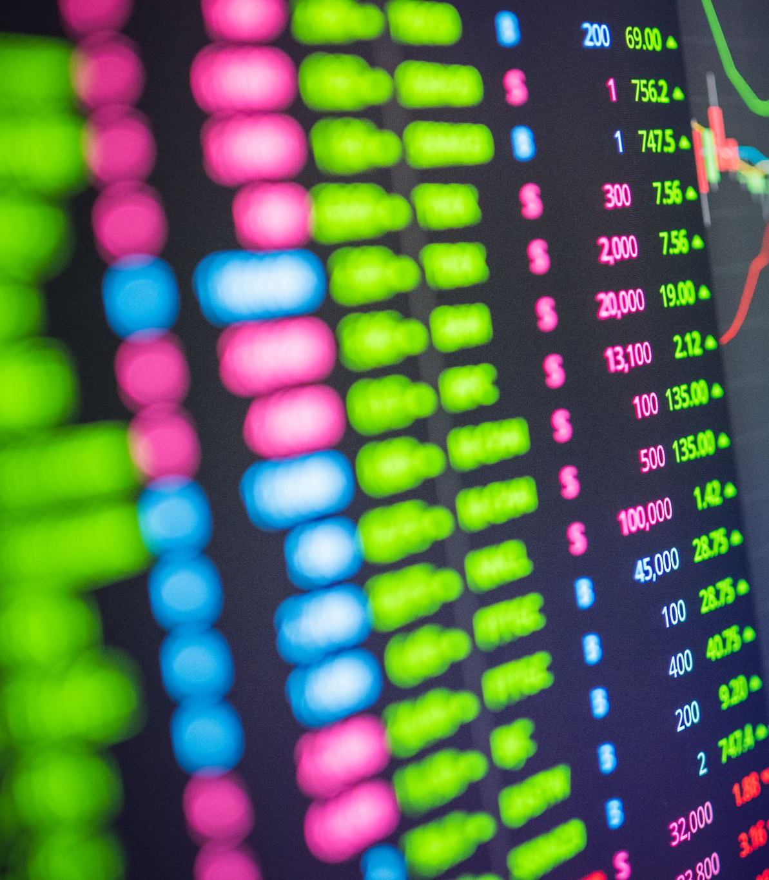
Risk-Free Paper Trading Application
Hong Hien Pham

Slide 2
Description
Based on the survey of Benefits Canada, 78% of participants have faced financial difficulties because of the high inflation (Staff). Among them, 67 % of participants aged 18 to 24 have no saving/retirement plans at all. Even though the banks have offered about 4% GIC rates, in August 2022, the Canadian inflation rate is even higher with a rate of 7% (Government of Canada). This means each year the funds in our accounts are losing their values by 3% with saving plans and 7% with non-saving plans. To prevent this loss, the stock market is a great way to solve this problem; however, the risk may be higher than savings. This has discouraged many people to enter to the stock market. Therefore, our paper trading application, named “Risk-Free Paper Trading”, will be an application which helps users to approach the stock market safely by allowing people to monitor stock prices, create and save accounts with different portfolios, buy and sell stocks virtually, show gains and losses, calculate passive incomes (from dividends) from stocks, and save memo for transactions with purchased reasons.

Slide 3
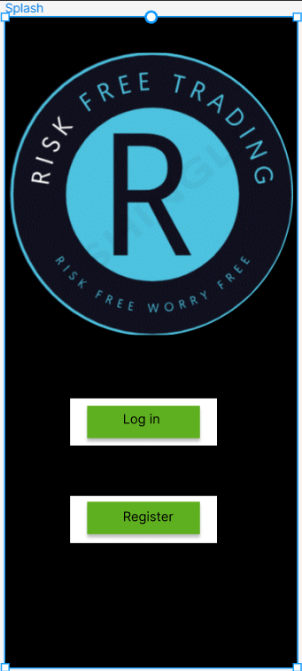
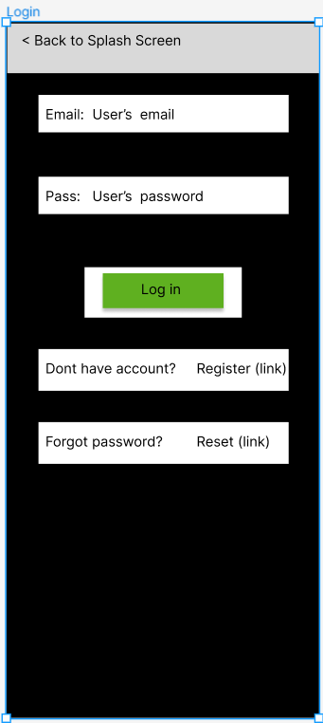
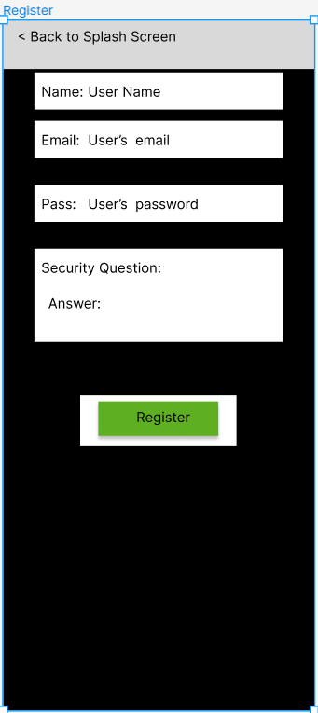
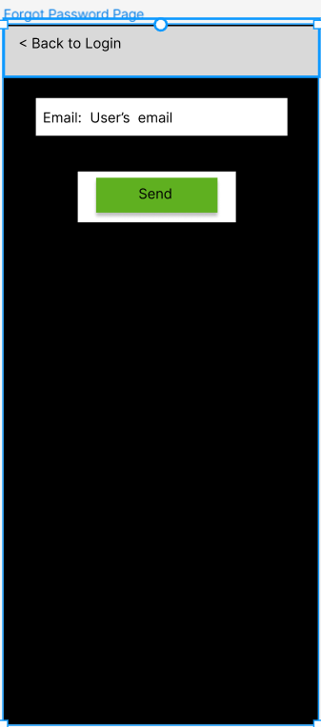
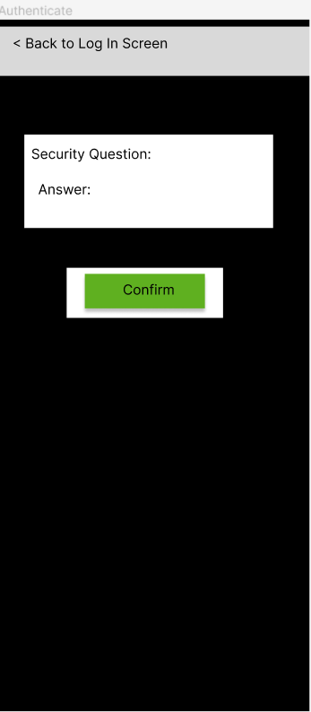
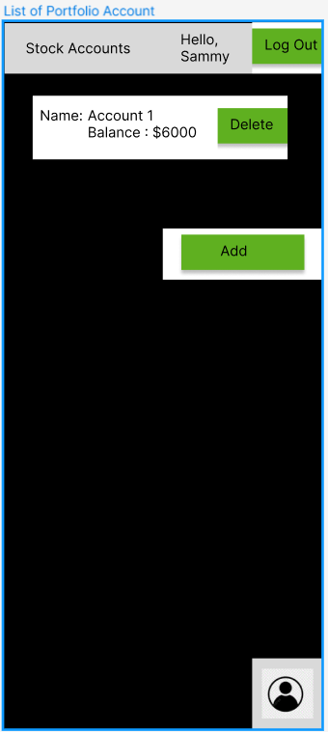
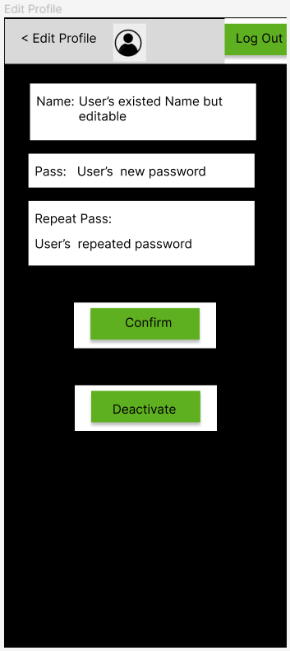
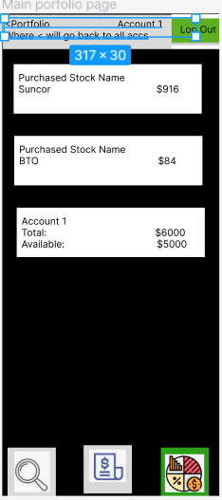
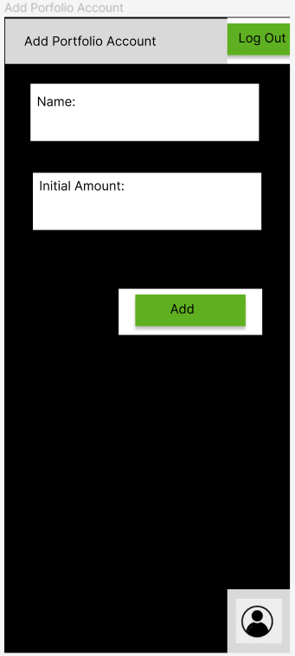
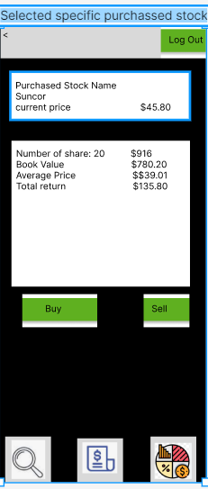
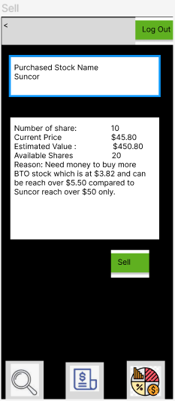
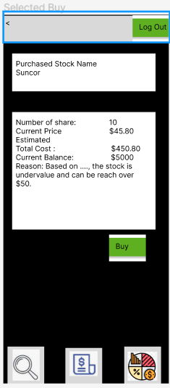
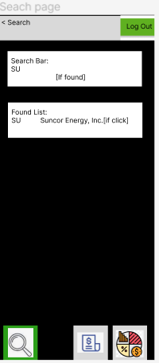
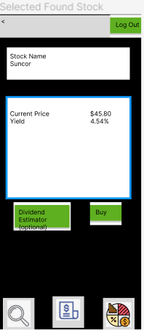
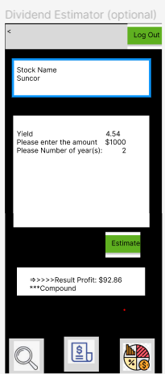
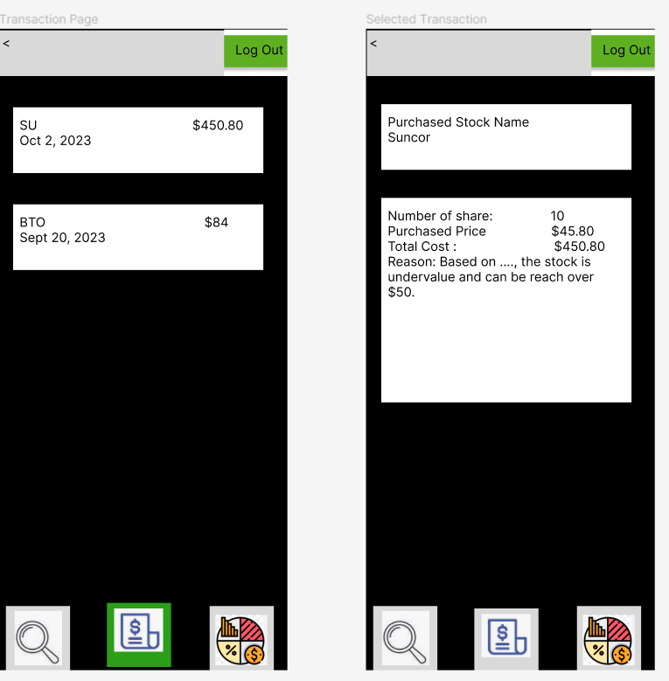
Mock Up Pages

Slide 4
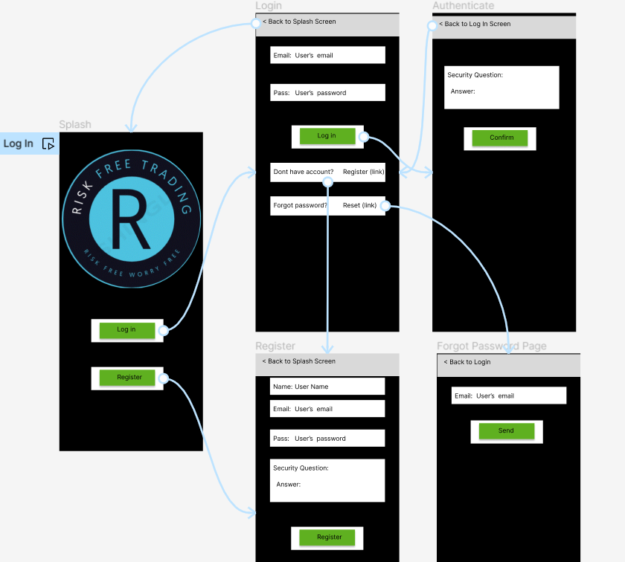
Log In Flow

Slide 5
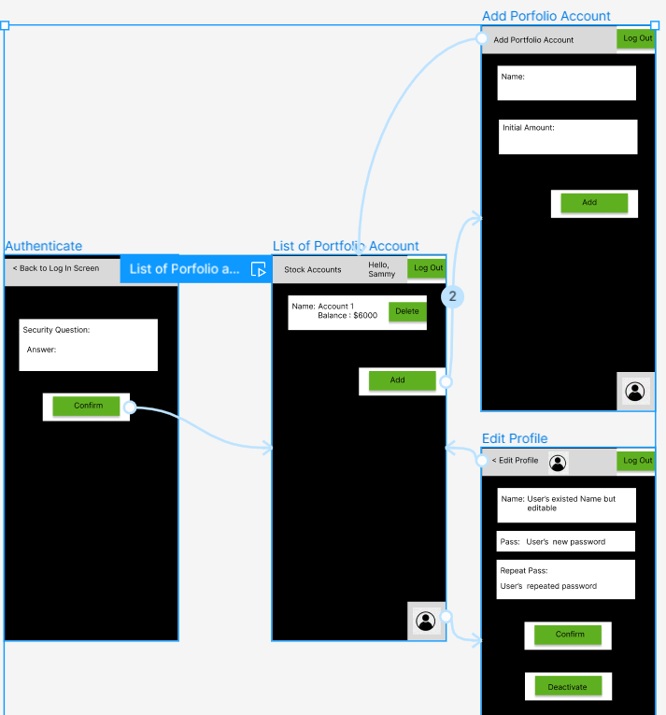
List of portfolio accounts flow
IF the users can log in successful, they will see the list of their portfolio accounts. They also click add to create new portfolio account where they can enter a nickname for that account and the initial desired amount. They can also change the user profile and the initial desired amount. They can also change the user profile info by clicking the human symbol butt

Slide 6
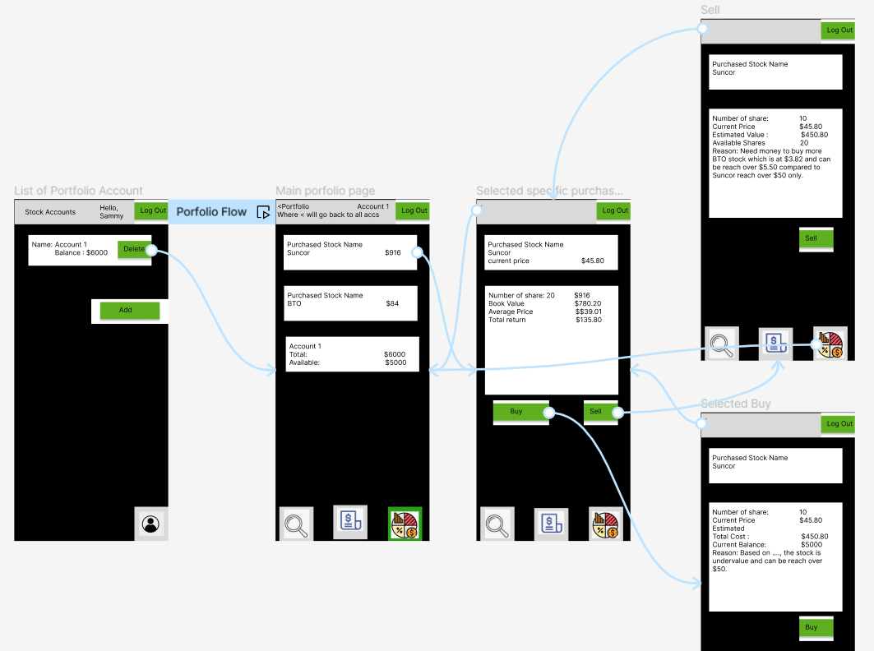
Selected Portfolio Account
After Selected the existed portfolio account, users will be guided to main portfolio page where users can see their purchased stocks, buy or sell them.

Slide 7
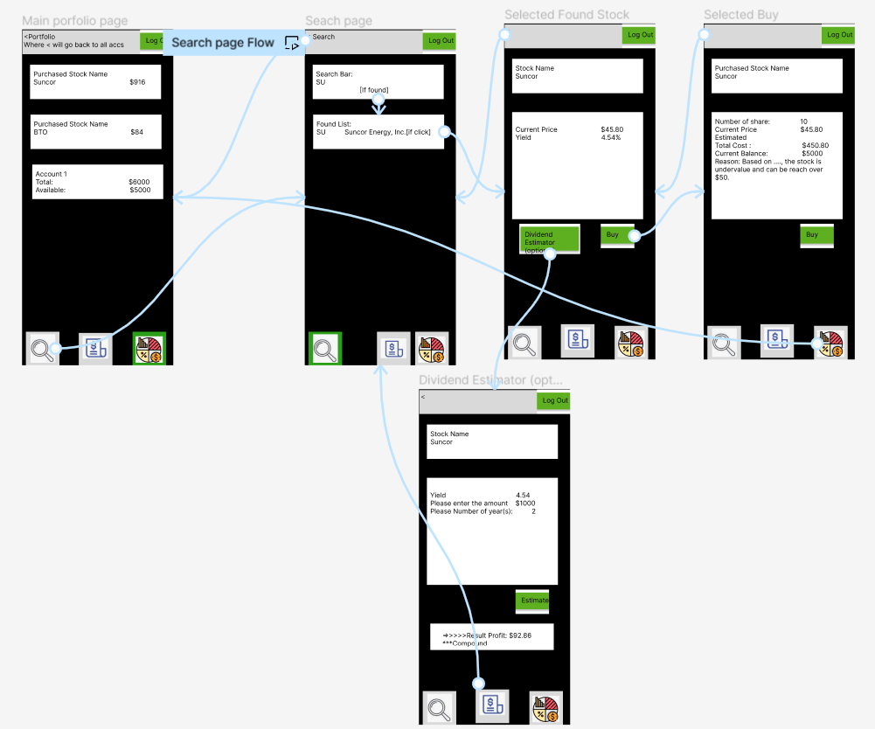
Search Flow
Users can search for stock by clicking the magnifier glass button located at the bottom navigation bar, enter the symbol of the desired stock. After that, users can click on found stock to see its info such as its current price and dividend yield. The users can also click on buy button to buy that stock or click on dividend button to estimate the dividend income if they enter a certain amount $ and number of holding years.

Slide 8
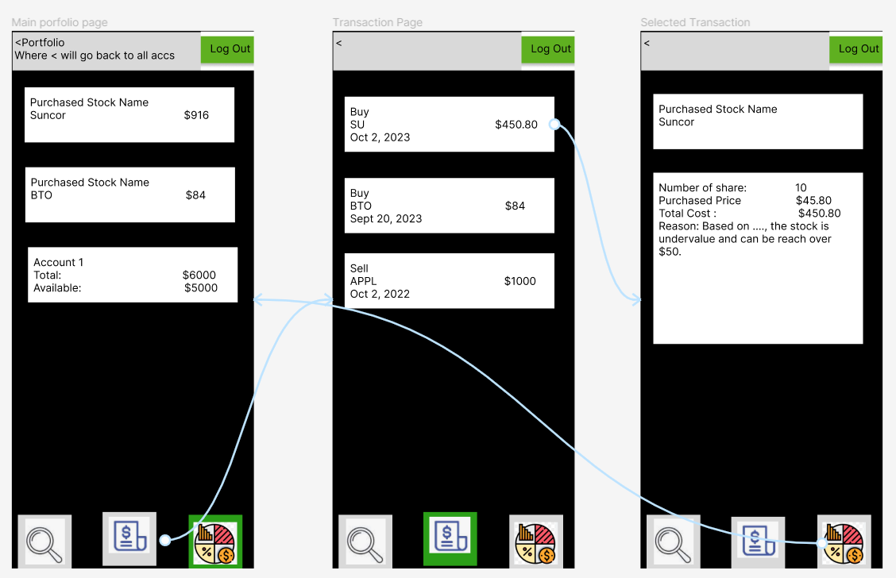
Transaction Flow
Users can click on $list Symbol to see all past transactions to understand the reason of buying or selling.

Slide 9
Implementation Plan
Due to personal issues, this project will be done by only 1 person(Hong Hien Pham) who will implement all roles such app GUI, Logic, and database interaction.
Database used for portfolio accounts, purchased stocks, and transactions is for SQL Lite
Though can be changed, for study, database for login/credentials info might be Firebase.
Stock search info will be fetched from Yahoo Finance API or Aletheia API if available since it is faster.

